Slide 1


DMG Assignment Part-2
Arvind Dwivedi
Chandana Srinivas
Narendra Kolhe
Saurabh Gulyani
Surabhi Kumar
Varun Saraogi
Clustering, Analysis, Insights, Stakeholders

Slide 2
Cluster Analysis

Slide 3
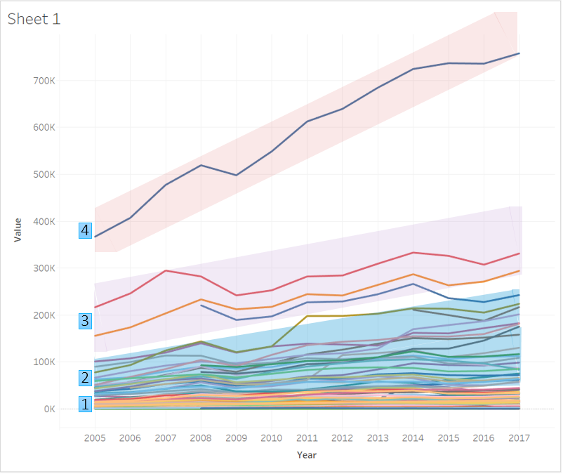
4 Cluster’s
Cluster | Country Count | Export Value (Billion $) | Avg/Country (Billion $)
1 | 168 | 11342.78 | 67.52
2 | 22 | 23885.91 | 1085.72
3 | 3 | 9056.59 | 3018.86
4 | 1 | 7710.91 | 7710.91
4
USA
3
FRANCE, GERMANY, UK
2
India, China, Singapore, Japan, Middle East
1

Slide 4
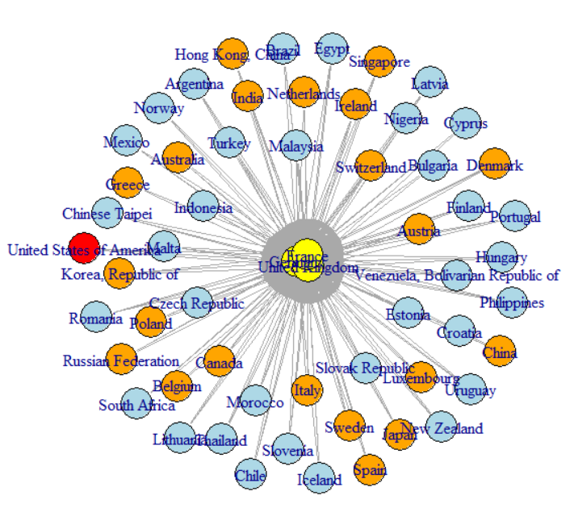
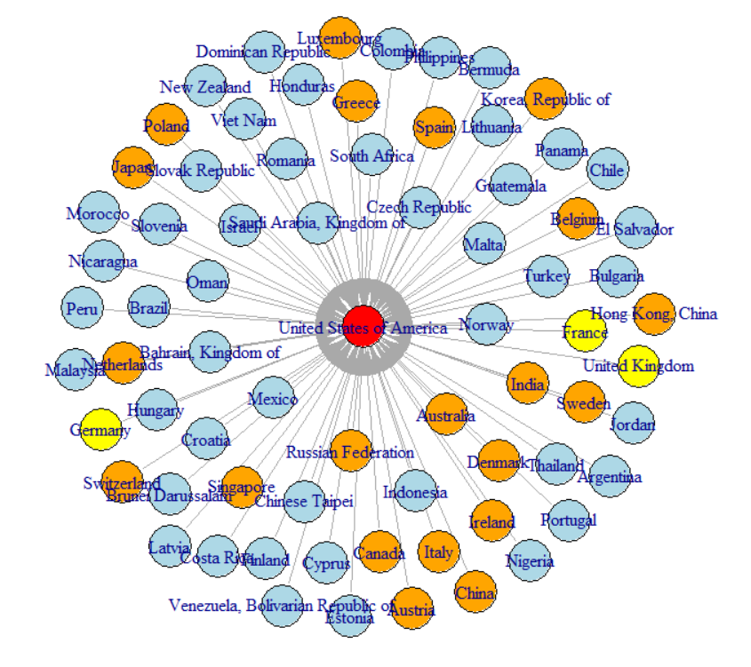
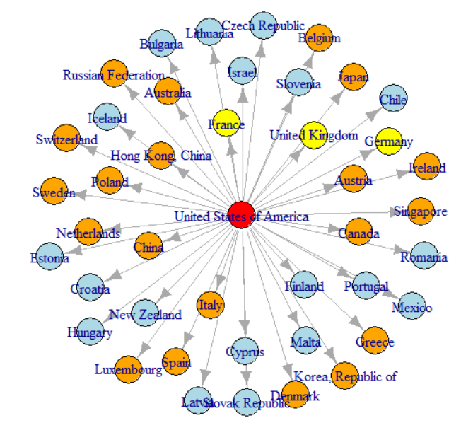
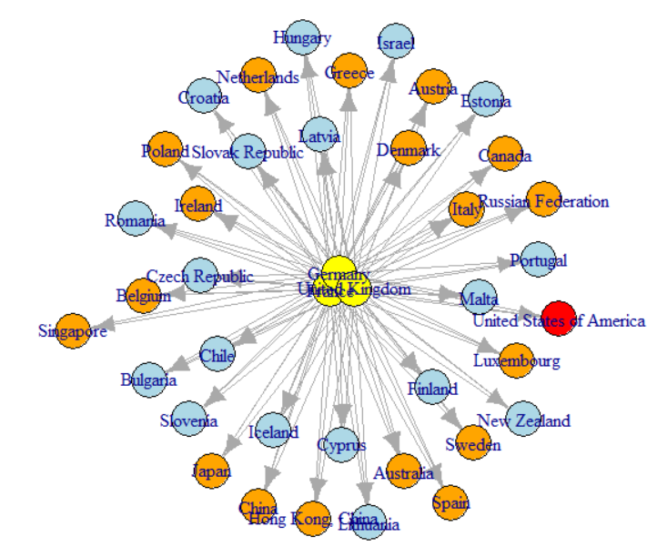
Graph Analysis
Cluster 3(FRANCE, GERMANY, UK)
Cluster 4 (USA)
France, Germany, UK majority doing business with USA, Developed and Developing countries compared to under developed countries.
USA is doing business across all cluster countries
https://www.isb.edu/

Slide 5
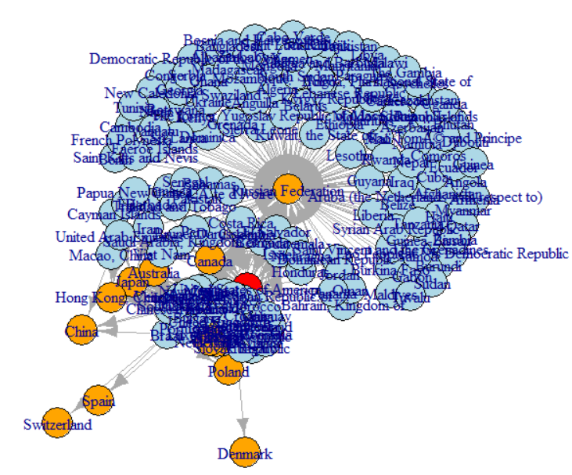
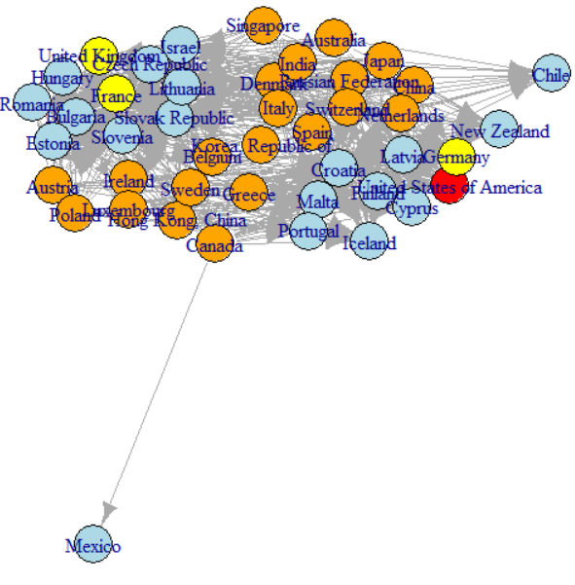
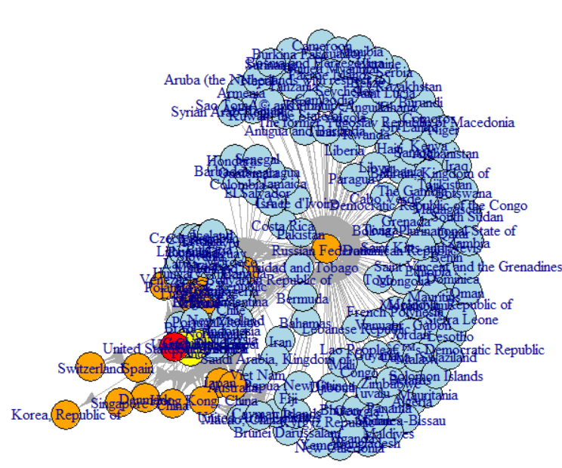
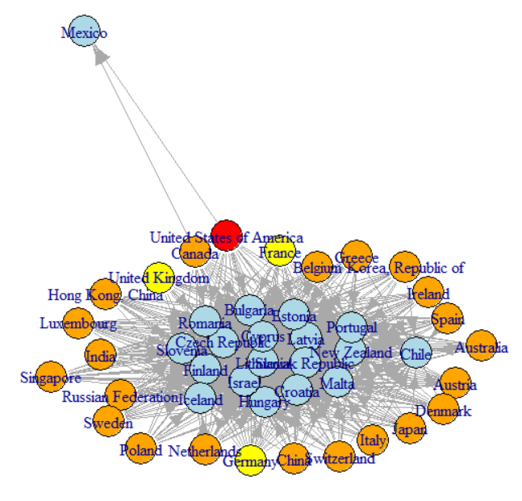
Graph Analysis
Cluster 2
Cluster 1
Under Developing countries majority doing business with Developing countries.
Cluster2 (Developing countries) doing business across all 4 clusters.

Slide 6
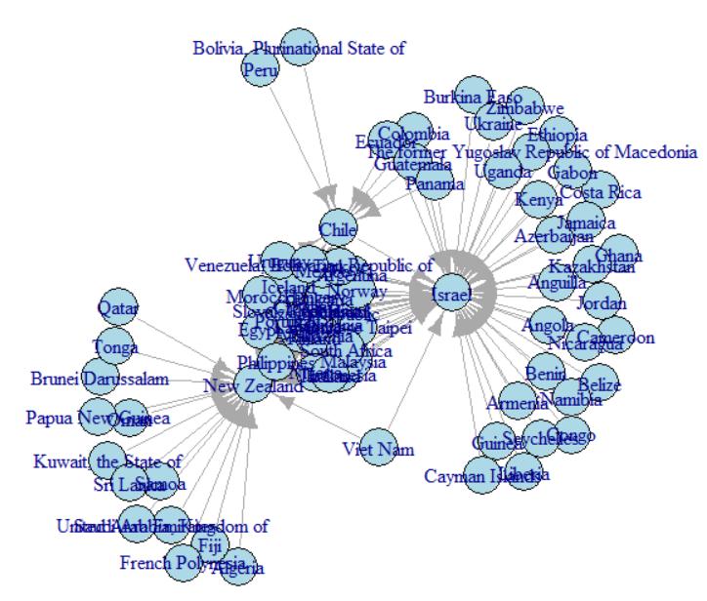
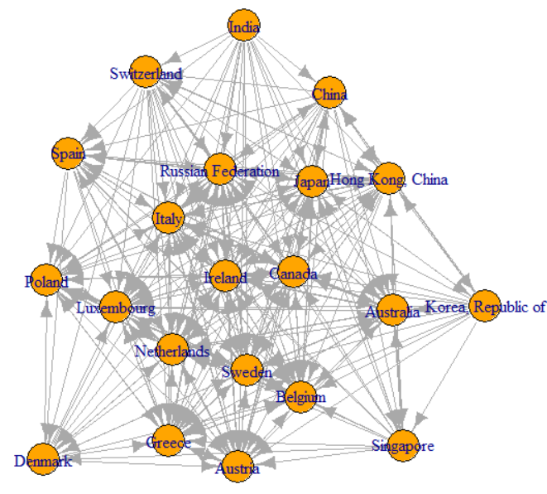
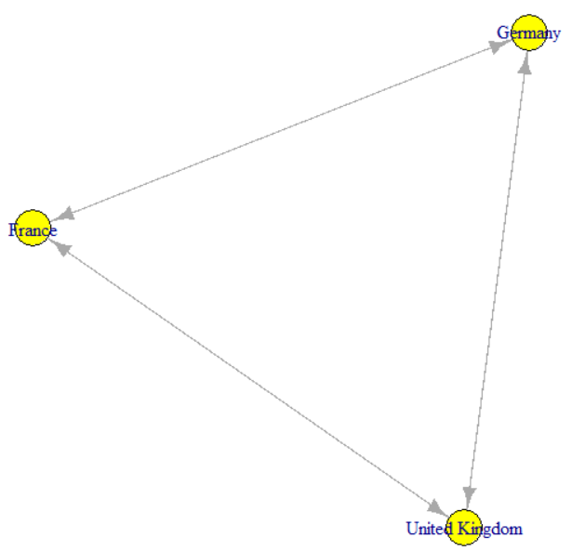
Graph Analysis
Within Cluster 1
Within Cluster 2
Within Cluster 3
All countries are well connected within clusters.

Slide 7
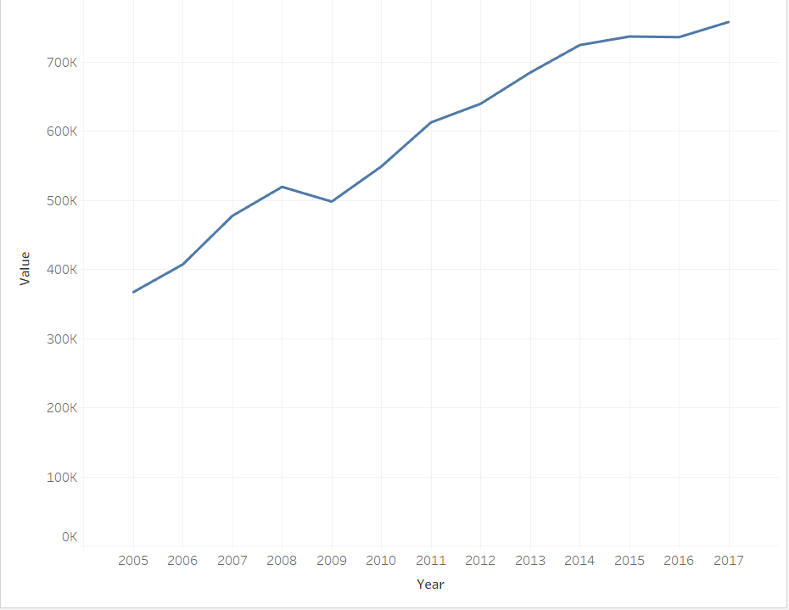
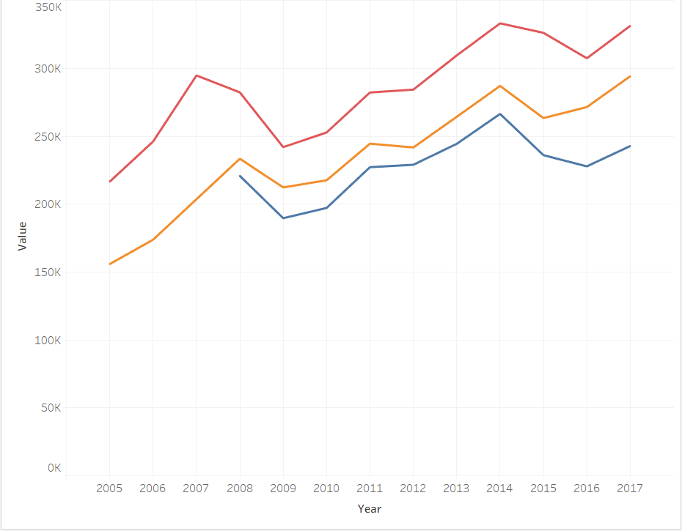
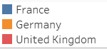
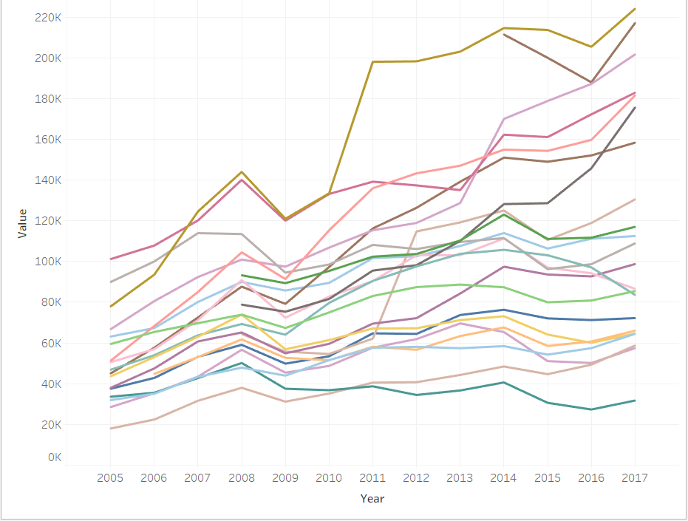
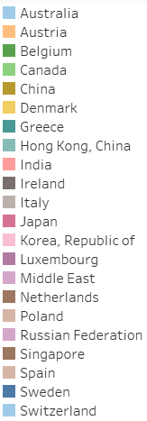
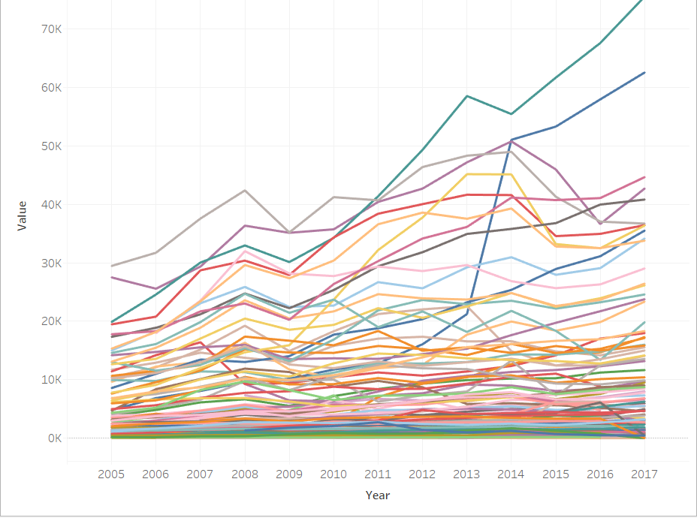
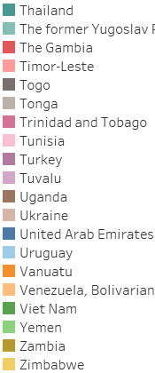
Cluster’s Overview
4
3
2
1

Slide 8
3 & 4

Slide 9
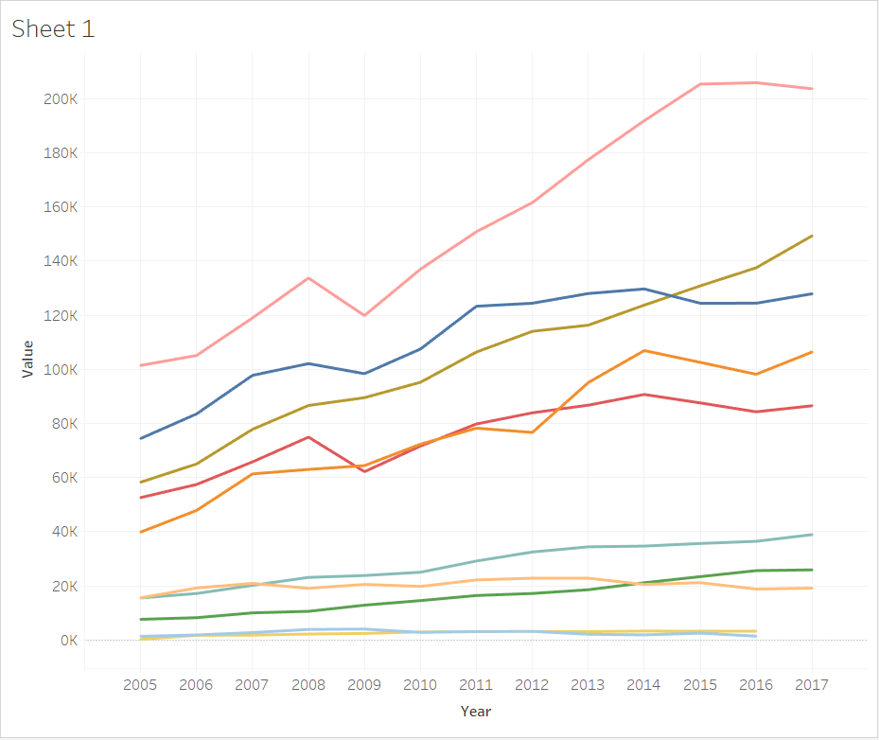

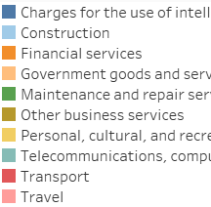
Cluster 4 Services Analysis and Recommendations
USA
Travel
Intellectual
Fin
Transport
Telecom, Compu, IT
All Services are showing uptrend.
Highest % Change – Travel
Recommended Services – Travel, Fin

Slide 10
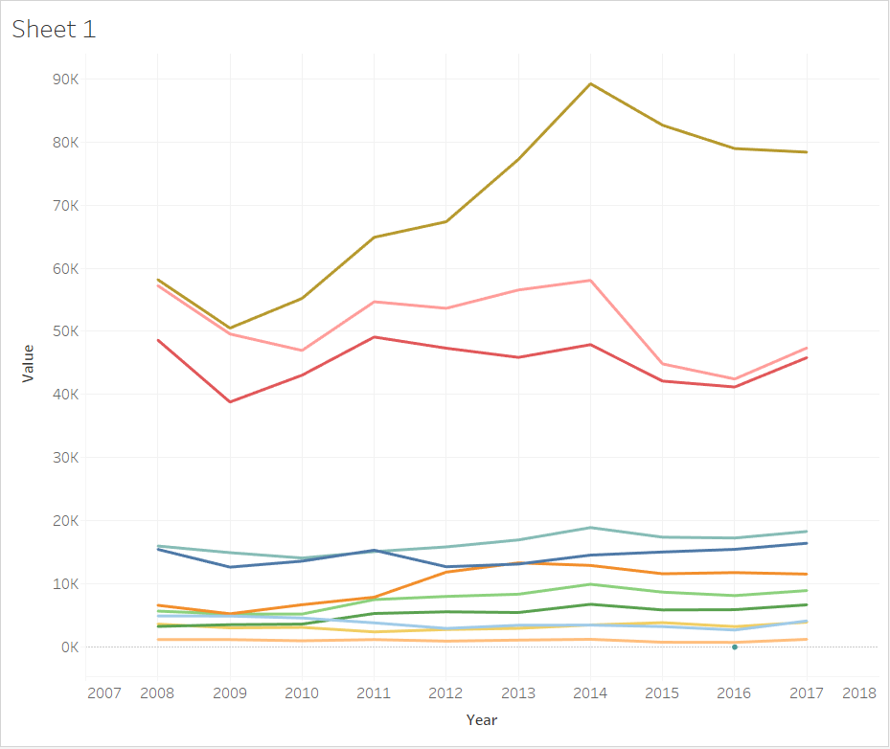

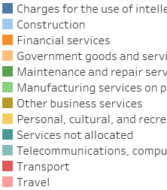
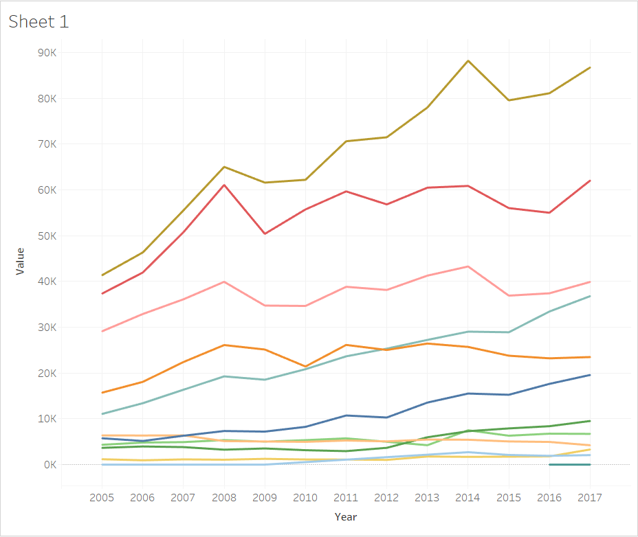
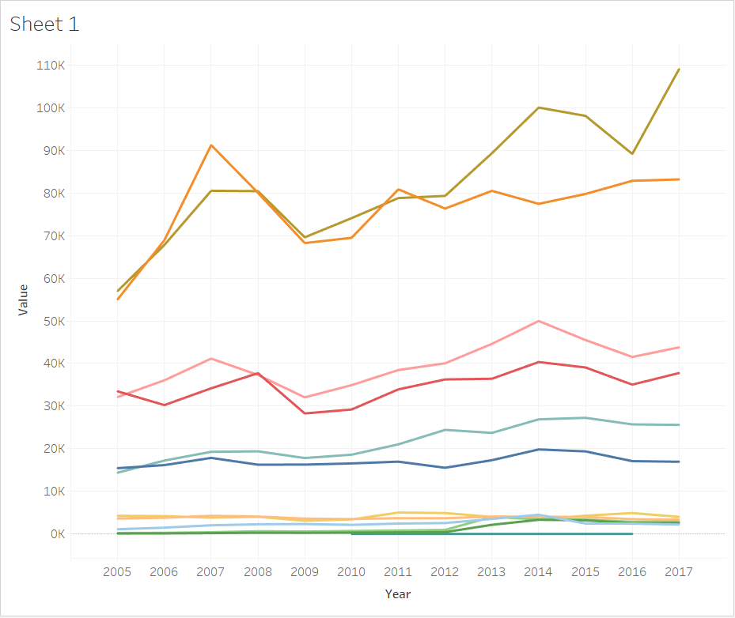


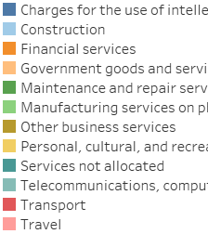

Cluster 3 Services Analysis and Recommendations
FRANCE
All services showing slight % increase throughout the years
Recommended
UK – Financial Services
Germany – Transport, Telecom. Computers, IT
Travel
3
Transport
Telecom, Compu, IT
GERMANY
UK
Transport
Fin
3
3
Travel
Travel
Telecom, Compu, IT
Transport
Fin
Telecom, Compu, IT
Intellectual
Intellectual
UK Recession
Brexit

Slide 11
2

Slide 12
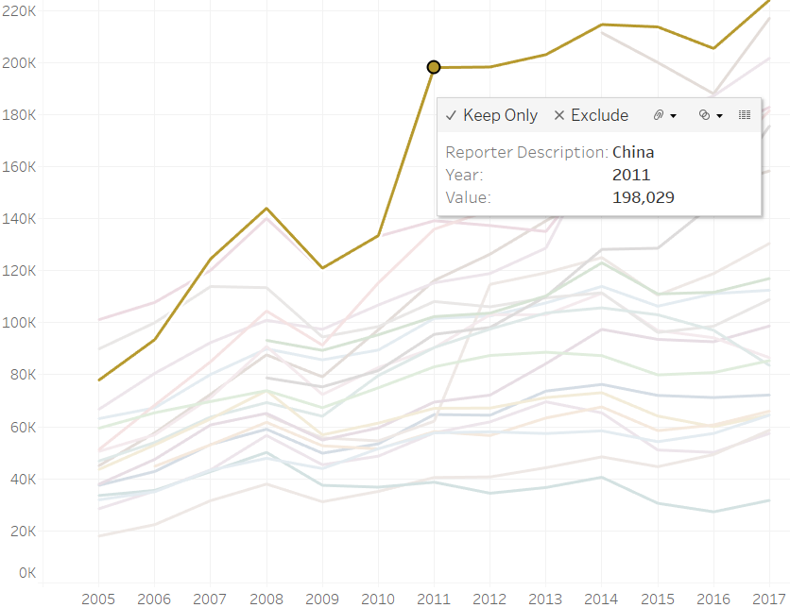
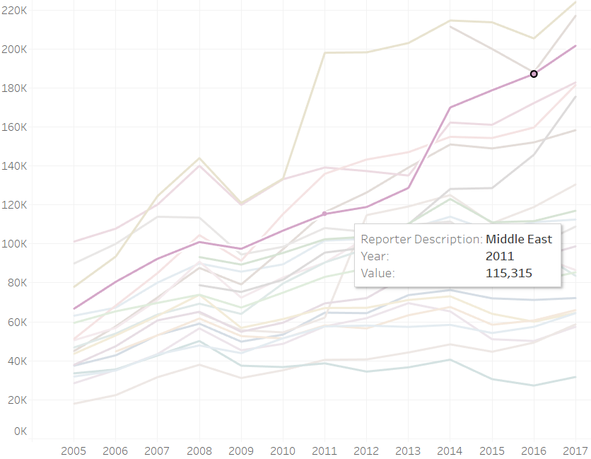
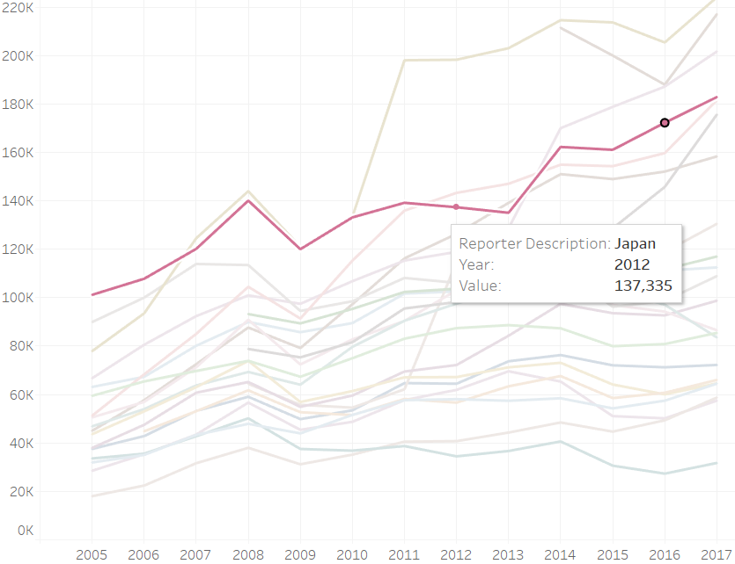
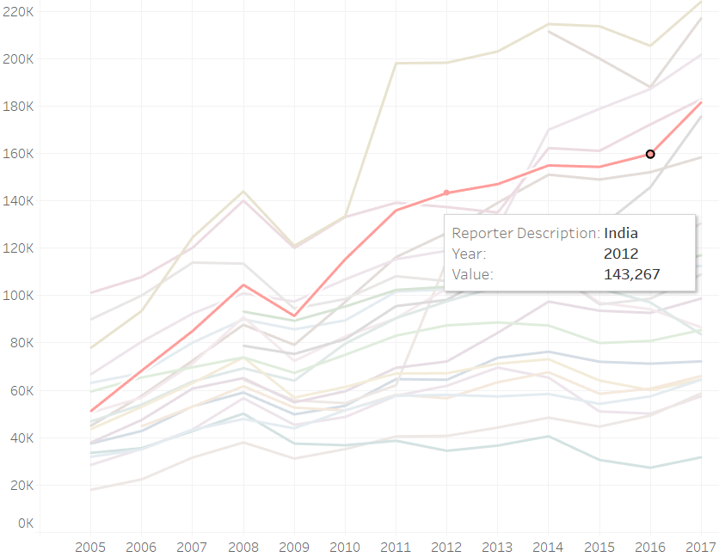
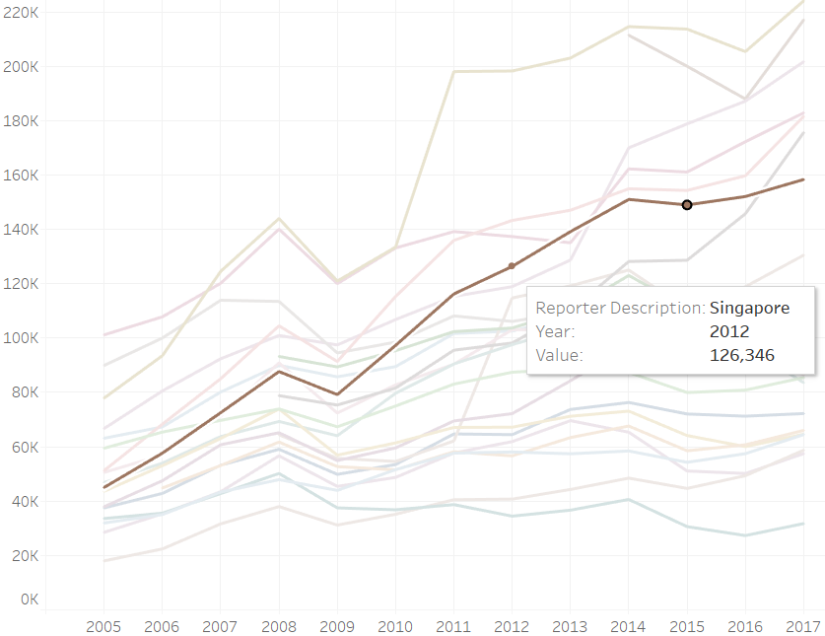
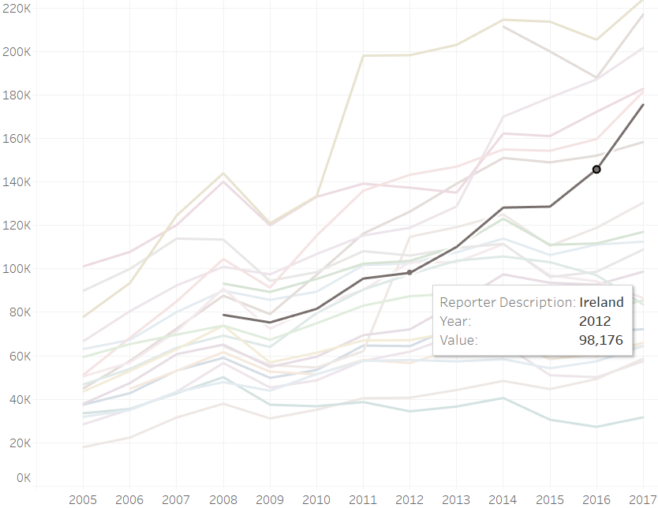
Cluster 2 – Champion’s
CHINA
MIDDLE EAST
JAPAN
INDIA
SINGAPORE
IRELAND

Slide 13
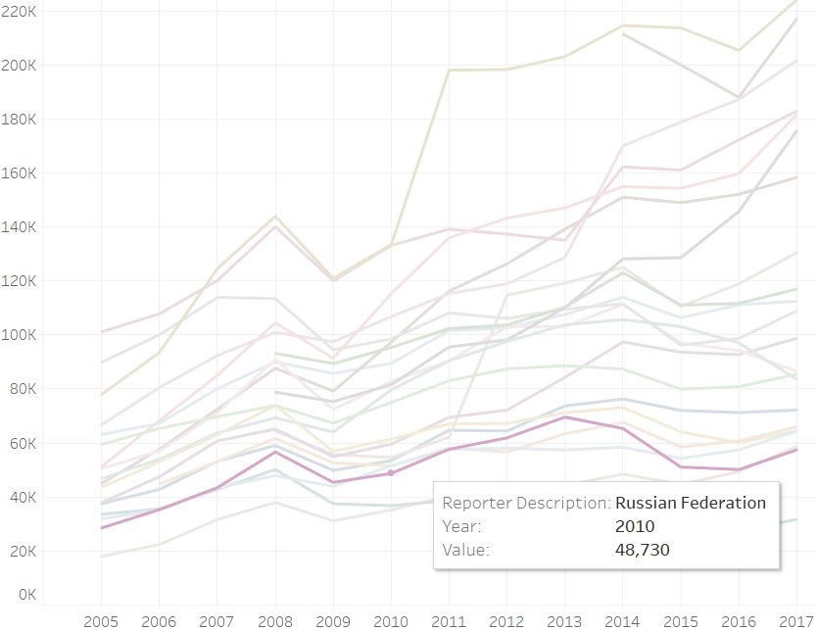
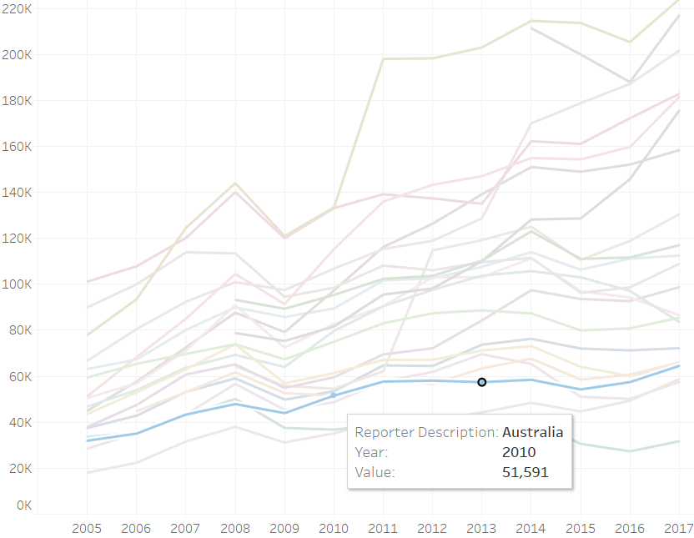
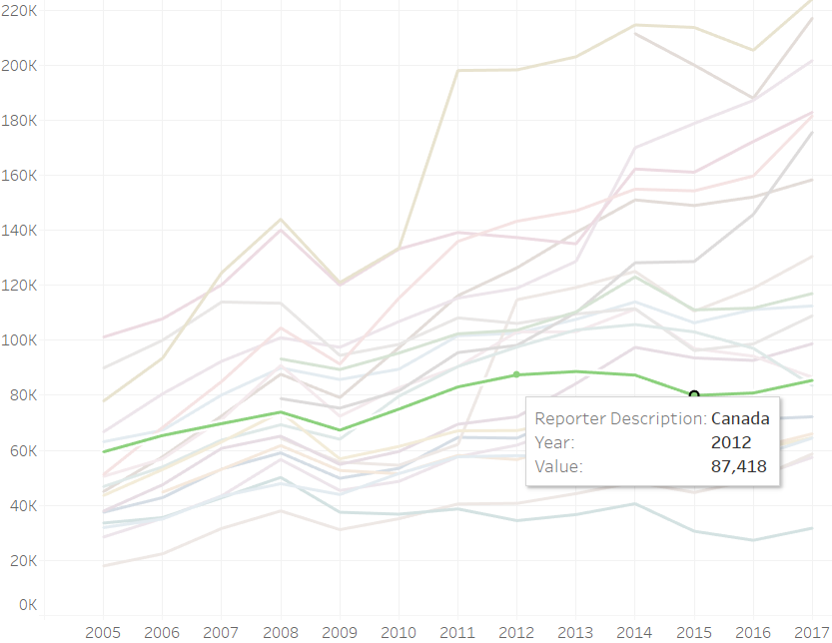
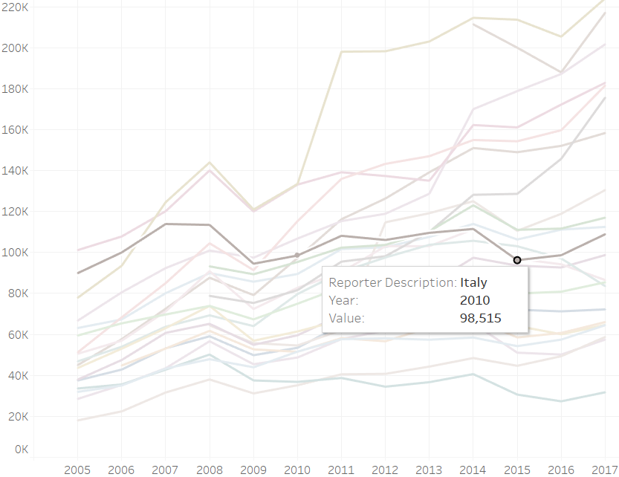
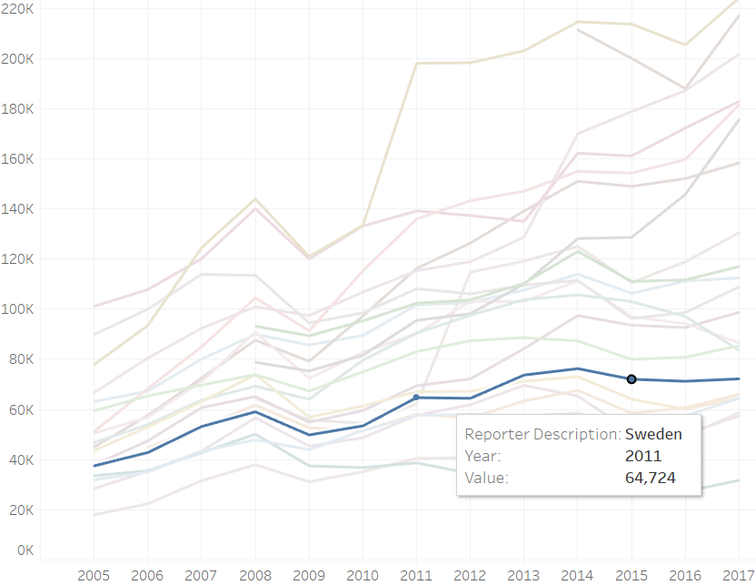
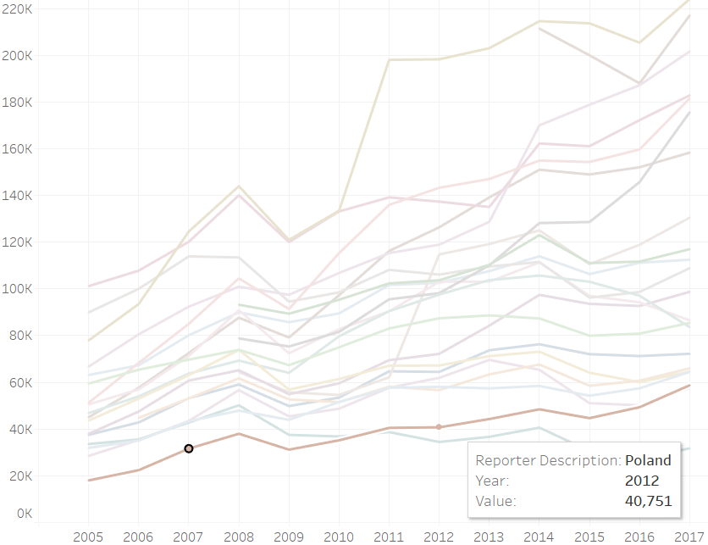
Cluster 2 – Rival’s
RUSSIA
AUSTRALIA
AUSTRALIA
CANADA
ITALY
ITALY
SWEDEN
POLAND

Slide 14
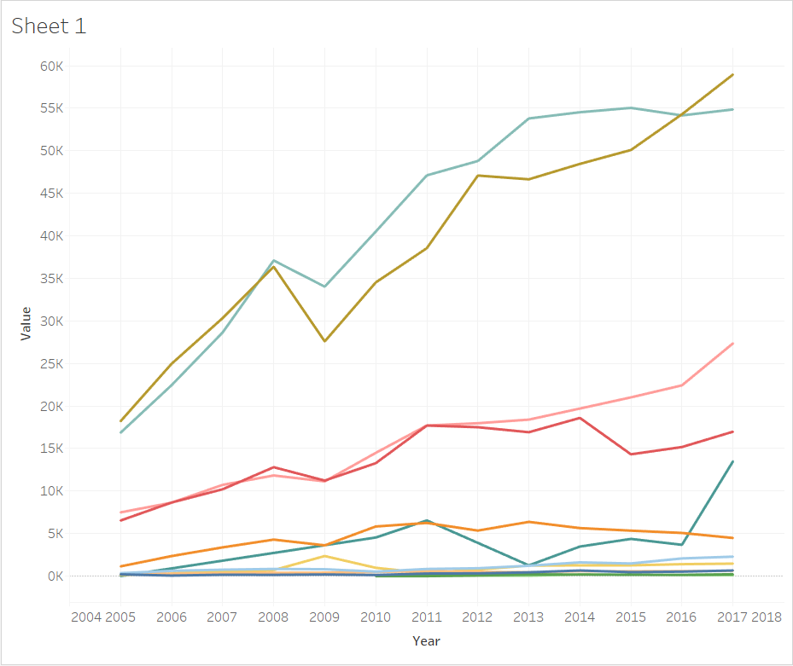
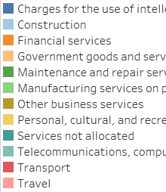
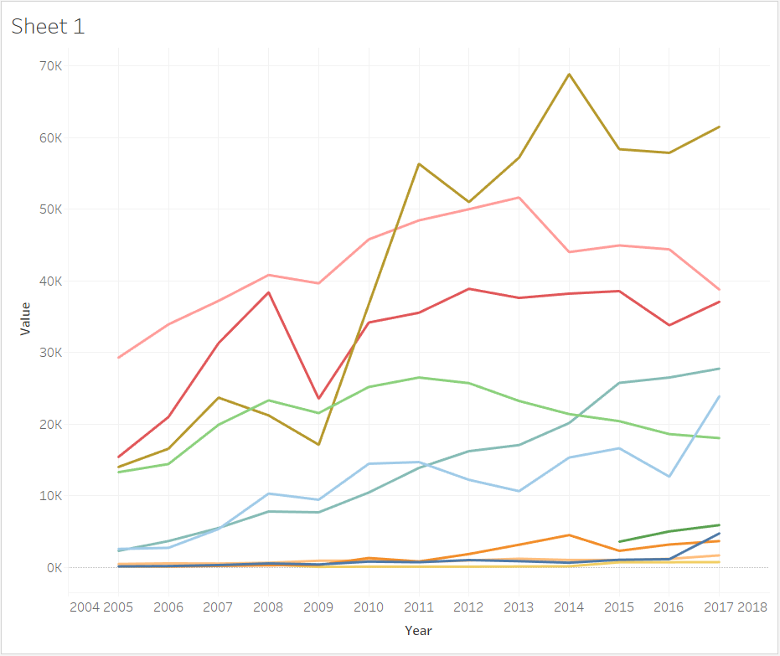
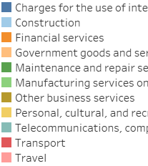


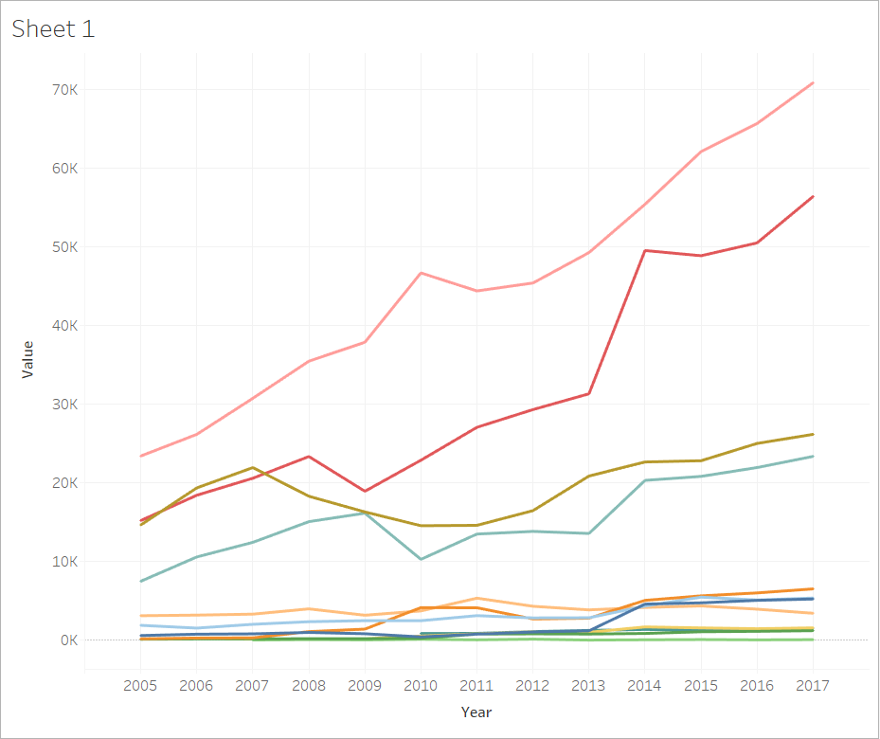

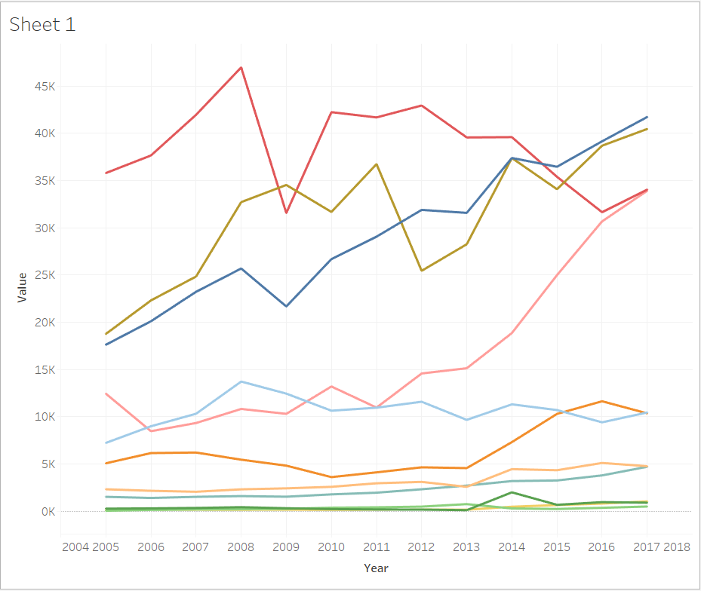
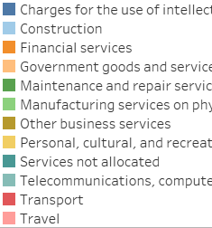
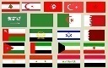

Cluster 2 Services Analysis and Recommendations
INDIA
CHINA
Telecom, Compu., IT
Travel
Transport
Travel
Mfg.
Telecom, Compu., IT
Mfg is down after 2011.
Recommended
Commu., IT, Computer
Transport
All services showing healthy & up trending
Recommended
Telecom & Computer, IT
Travel & Transport
Fin
Construction.
MIDDLE EAST
JAPAN
Travel
Transport
Transport
Travel
Recommended
Travel & Transport
Intellectual
Recommended
Intellectual
Travel
Telecom, Compu., IT
Construction.
Fin
2

Slide 15
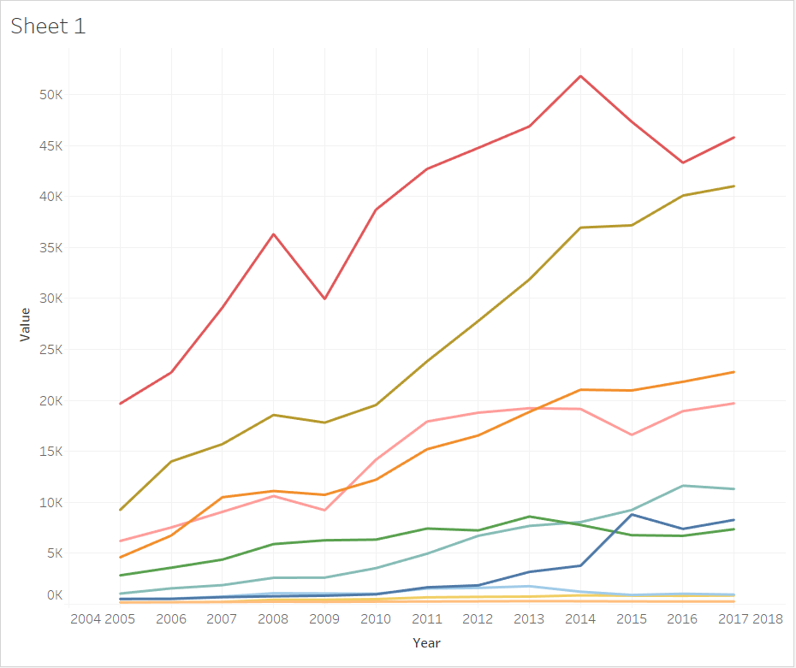

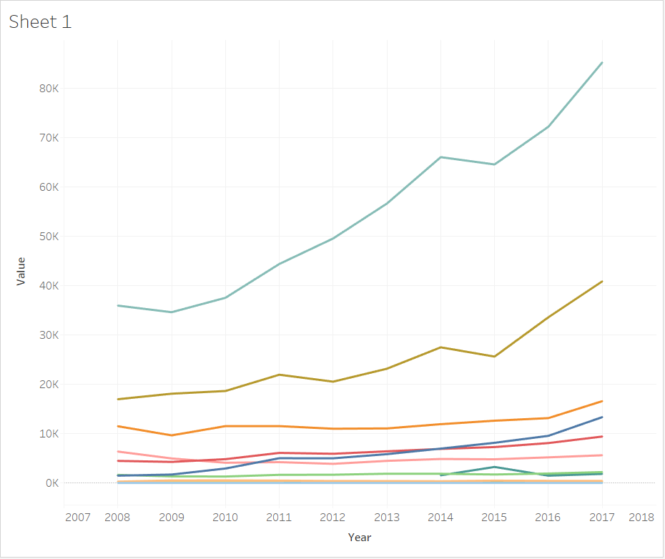
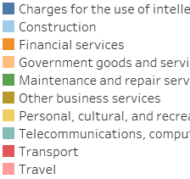

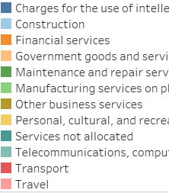
Cluster 2 Services Analysis and Recommendations
SINGAPORE
IRELAND
Transport
Telecom, Compu., IT
2
2
Fin
Travel
Telecom, Compu., IT
Recommended
Transport
Financial Services
Travel
Fin
Recommended
Commu, IT., Computers
Intellectual
2

Slide 16
1

Slide 17







Cluster 1 Services Analysis and Recommendations
UAE
THAILAND
Travel
Transport
Travel
Recommended
Travel
Recommended
Travel & Transport
2

Slide 18
THANK YOU
https://www.isb.edu/

